Slide 1
On The Boundary Condition of a Stationary Boussinesq Type Equation
Soliton Solutions
K. Angelow, N. Kolkovska

Slide 2
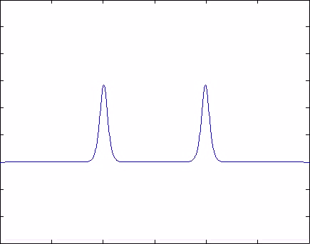
Characteristics of a soliton
A soliton is a traveling wave which:
maintains its shape
is localized within a region
interacts with other solitons, and emerge from the collision unchanged

Slide 3
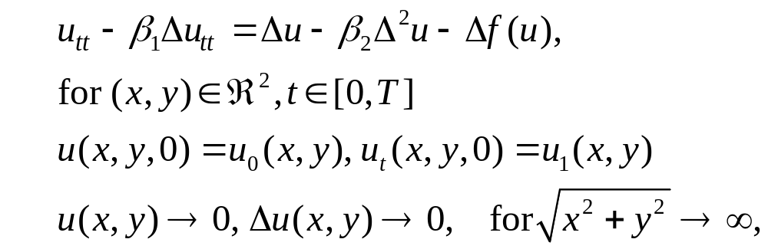
The Boussinesq Paradigm Equation (BPE)
where
f(u) = α u²(x, y, t)
α ,β₁ ,β₂ > 0
∆ is the Laplace Operator

Slide 4
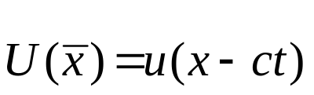

The Stationary BPE
One dimensional case
where we set in order to obtain a traveling wave solution along the x axis.
Two dimensional case
where w.l.o.g. we set in order to obtain a traveling wave solution along the y axis.

Slide 5
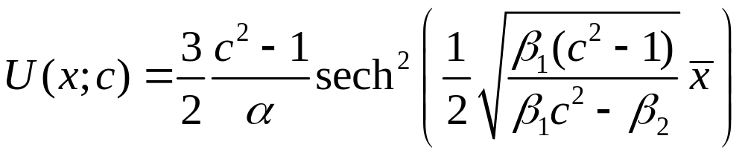
Solution of the stationary BPE
One dimensional case
Analytical solution is given by⁽¹⁾:
is a soliton
  interacts with other solitons, and emerge from the collision unchanged
preserves energy⁽¹⁾
¹N. Kolkovska, Two Families of Finite Difference Schemes for Multidimensional Boussinesq Paradigm Equation

Slide 6
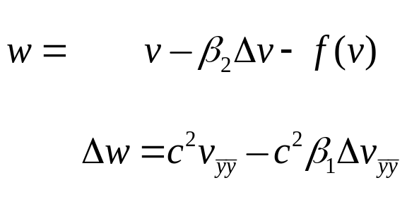
Two dimensional case
Numerical Solution - Simple Iteration Method
Reduce the 4th order of the 2D elliptic BPE⁽²⁾:
Avoid the trivial solution w = v = 0
²C. I. Christov, Numerical implementation of the asymptotic boundary conditions for steadily propagating 2D solitons of Boussinesq type equation, Math. Computers Simul., 82 (2012) 1079 - 1092.

Slide 7
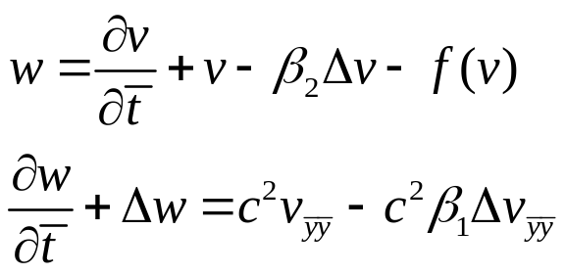
Two dimensional case
Numerical Solution- Simple Iteration Method
Reduce the 4th order of the 2D elliptic BPE⁽²⁾:
Avoid the trivial solution w = v = 0
²C. I. Christov, Numerical implementation of the asymptotic boundary conditions for steadily propagating 2D solitons of Boussinesq type equation, Math. Computers Simul., 82 (2012) 1079 - 1092.

Slide 8
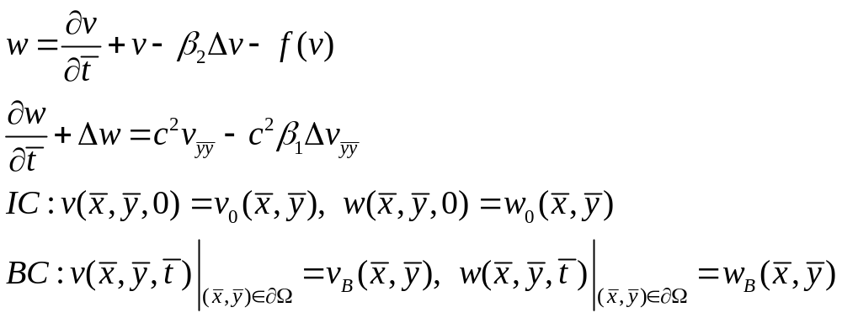
Two dimensional case
Numerical Solution- Simple Iteration Method
Reduce the 4th order of the 2D elliptic BPE⁽²⁾:
Avoid the trivial solution w = v = 0⁽²⁾
²C. I. Christov, Numerical implementation of the asymptotic boundary conditions for steadily propagating 2D solitons of Boussinesq type equation, Math. Computers Simul., 82 (2012) 1079 - 1092.

Slide 9
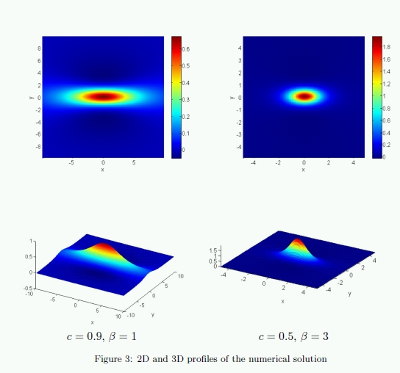
Two dimensional case

Slide 10
Uniform vs Non-uniform Grid
 | Uniform grid advantages | Non-uniform grid advantages
Hyperbolic equation | 1. Possibility for colliding two or more solitons 2. Better capabilities of moving the soliton in a larger time domain [0, T]
Elliptic equation |  | 1. Less points in the domain Ω increases the convergence speed of the iterative algorithm quadratically

Slide 11
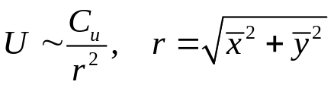
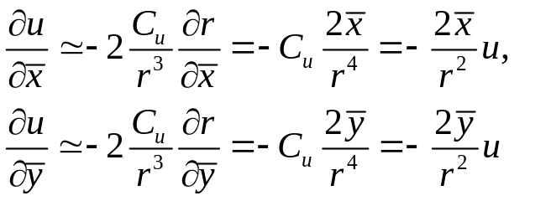
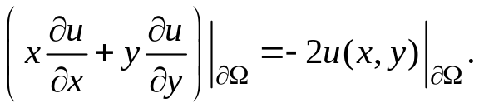
Asymptotic
The asymptotic of the solution is proven to be with an algebraic decay⁽²⁾:
The asymptotic satisfies:
Thus the old⁽²⁾ boundary condition is defined by:
²C. I. Christov, Numerical implementation of the asymptotic boundary conditions for steadily propagating 2D solitons of Boussinesq type equation, Math. Computers Simul., 82 (2012) 1079 - 1092.

Slide 12
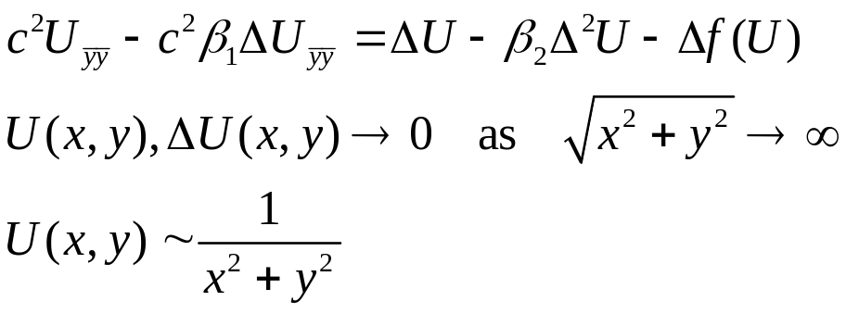
New Boundary Condition
Consider the stationary BPE for sufficiently large r
Insert the asymptotic values
Neglect the higher order terms of the r-expansion

Slide 13
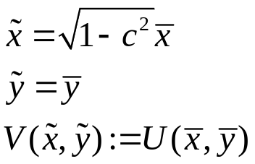
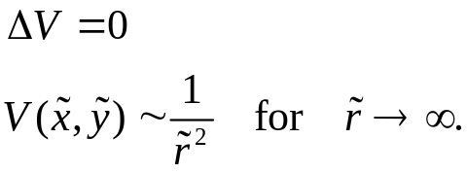
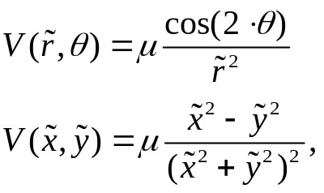
New Boundary Condition
The variable change⁽³⁾:
The Laplace equation:
The solution given in the literature which satisfies the 1/r² asymptotic is:
where µ is scale factor which is to be defined.

Slide 14
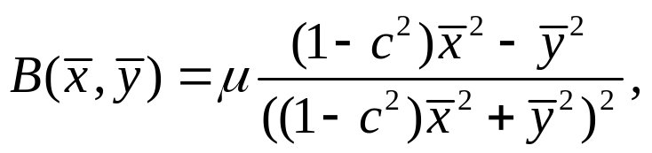
New Boundary Condition
Boundary function in the old coordinate system:

Slide 15
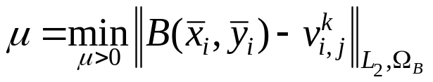



New Boundary Condition
Resolve the scaling factor µ
Given a numerical solution v^{k}, at the time level t_{k} we choose µ as minimizer of
where
v^{k}_{i,j} is the numerical solution at
Ω_{B} includes not only the boundary nodes on but also inner nodes near boundary

Slide 16

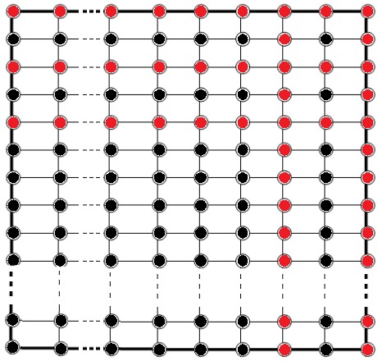
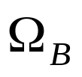

Domain
red points
red and black points

Slide 17

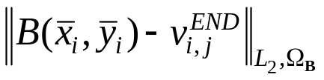

Validation of Boundary Condition
Domain size L_{x}=L_{y} |  | µ
20 | -2.23e-04 | 1.9355e-01 | 4.17e-05
40 | -5.65e-05 | 1.9369e-01 | 4.42e-06
80 | -1.41e-05 | 1.9378e-01 | 7.56e-07
160 | -3.53e-06 | 1.9381e-01 | 7.44e-10
where:
The initial problem is solved with parameters α = 1, β = 3, c = 0.45, h = 0.5 (domain discretization step size).
Results:
The values of v^{END} (second column) decay with a rate of 1/r²
μ parameters settle down as the computational box enlarges
Boundary function becomes more precise for larger domains

Slide 18
Validation of Boundary Condition
Domain size L_{x}=L_{y} |  | µ
20 | -2.23e-04 | 1.9355e-01 | 4.17e-05
40 | -5.65e-05 | 1.9369e-01 | 4.42e-06
80 | -1.41e-05 | 1.9378e-01 | 7.56e-07
160 | -3.53e-06 | 1.9381e-01 | 7.44e-10
where:
The initial problem is solved with parameters α = 1, β = 3, c = 0.45, h = 0.5 (domain discretization step size).
Results:
The values of v^{END} (second column) decay with a rate of 1/r²
μ parameters settle down as the computational box enlarges
Boundary function becomes more precise for larger domains

